Slide 1
CASE STUDY FOR CREDIT ANALYSIS USING (EDA)
Priyanka Narode

Slide 2
INTRODUCTION
▶ This assignment aims to give an idea of applying EDA(exploratory data analysis) in a real business
scenario.
▶ The basic understanding of risk analytics in banking and financial services and understand how data is
used to minimize the risk of losing money while lending to customers.

Slide 3
Steps to Do
PROBLEM STATEMENT UNDERSTANDING
DATA UNDERSTANDING(APPLICATION DATA)
DATA CLEANING: IDENTIFICATION OF MISSING VALUES AND OUTLIER
DATA IMBALANCE
SANITY CHECKS (checking negative and null values)
UNIVARIATE ANALYSIS
BIVARIATE ANALYSIS

Slide 4
Data Understanding (Application Data)
Checking Shape, Info, D-Types , size and Describe of the application data and pervious application data to get quick understanding of the data.

Slide 5
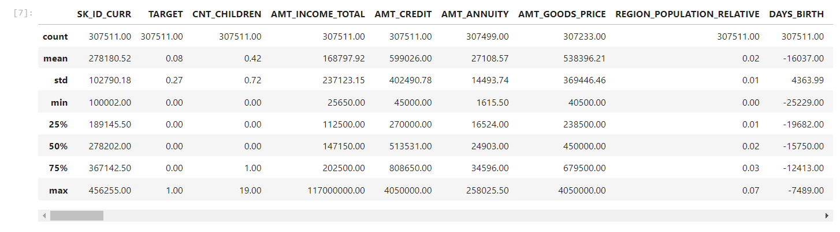
Describe (application data)

Slide 6
Data Cleaning
Identification of Missing Values and Treatment:
There were several Columns with missing value percentage greater than 40% so we dropped them.
Remaining columns with missing values we imputed them with mean/median/mode as required.
Outliers: There were several columns which have outliers present in them. Depicted through boxplot in columns named as :
AMT_ANNUITY
AMT_GOODS_PRICE
NAME_TYPE_SUITE
OCCUPATION_TYPE
•

Slide 7
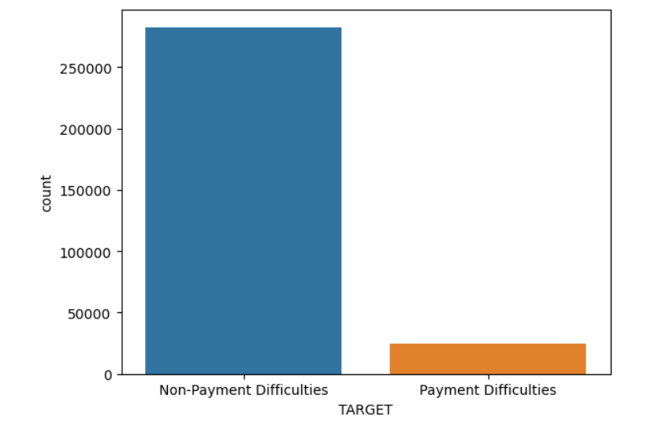
DATA IMBALANCE
We observed the data set it was highly imbalanced almost 91.9% clients were Non- Payment Difficulties(0) and about 8.1% for Payment Difficulties(1).

Slide 8
Missing Values
Doing analysis through the data observed some columns have negative values, Missing Values, Validate Data Type. So to correct them we did sanity checks in these columns named as;
“DAYS_BIRTH",
"DAYS_EMPLOYED",
"DAYS_REGISTRATION",
"DAYS_ID_PUBLISH",
"DAYS_LAST_PHONE_CHANGE”

Slide 9
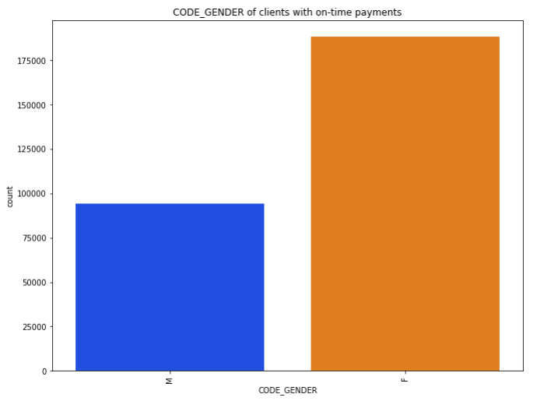
Bivariate Analysis
We can say that most client are females, working, have secondary education and are married.
We can say taking loan from the bank someone accompanied with them as well

Slide 10
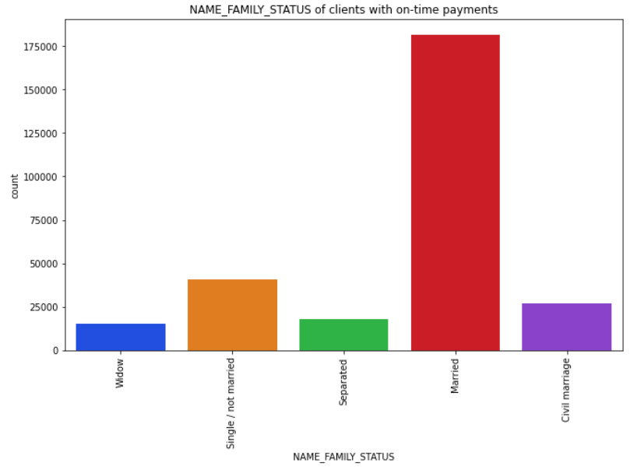
NAME_FAMILY_STATUS
Count of married people applying for a loan is higher than the rest.

Slide 11
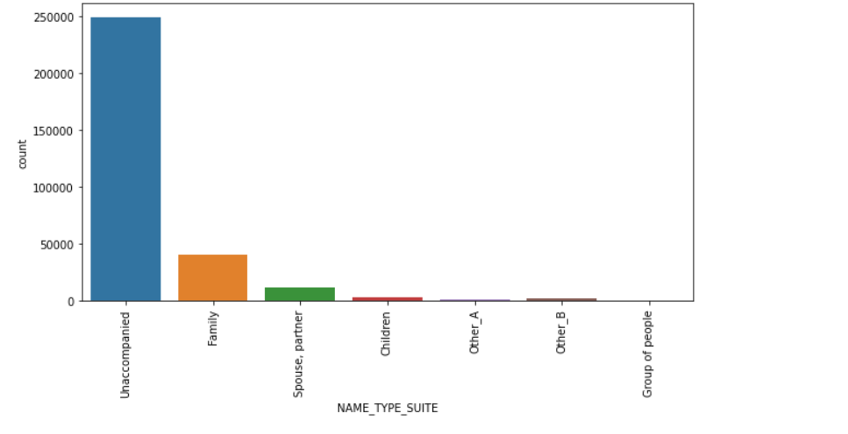
NAME_TYPE_SUITE
The majority of customers are unaccompanied, with family being the next largest group
This shows that most customers tend to be alone rather than in groups.

Slide 12
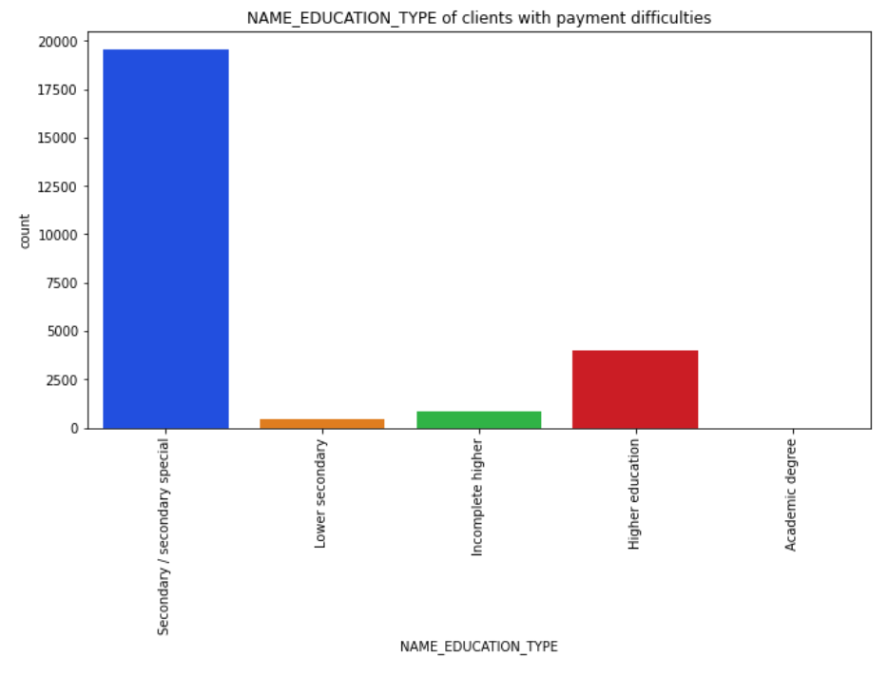
Client with Secondary Education are more likely to apply for the loan.

Slide 13
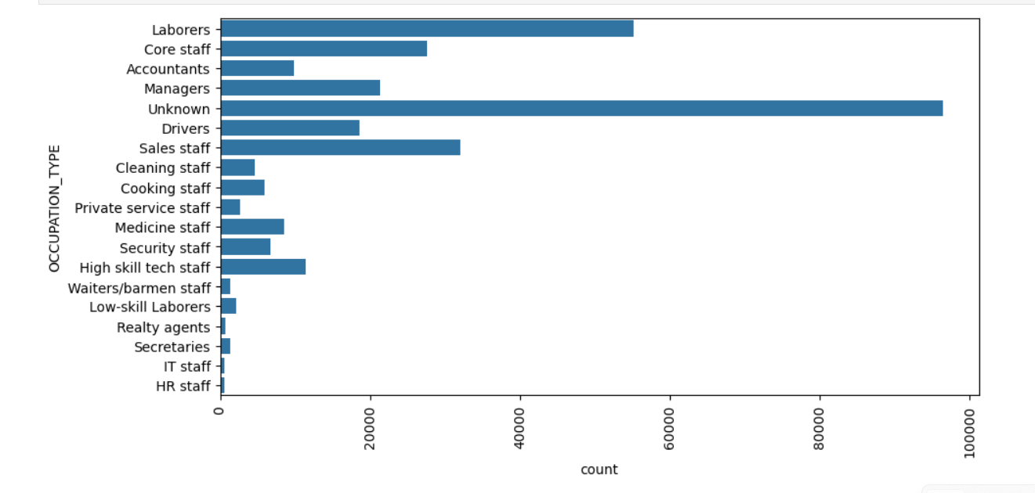
OCCUPATION_TYPE
CONCLUSION FROM ANALYSIS:
We observed that there is sharp increase in labours category in payment
The graph is showing clearly that labourer’s are the most applied applicants for loans.

Slide 14
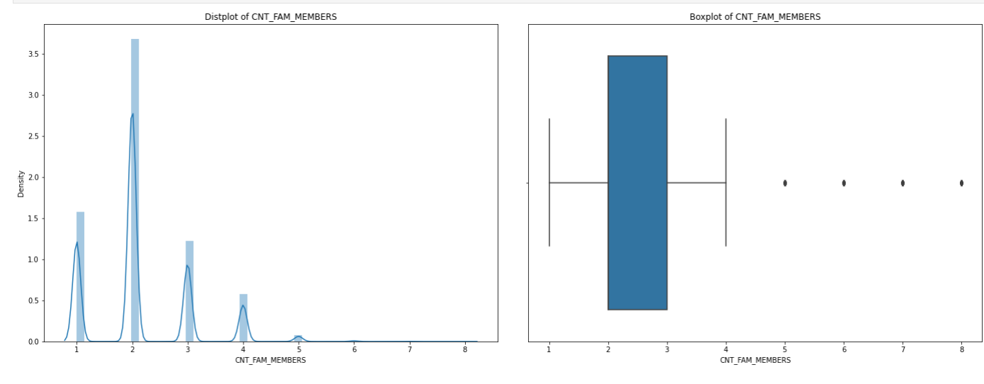
Analysis on CNT_FAM_MEMBERS
Applicants with 5 or more family members are clearly outliers

Slide 15
CONCLUSION
Data is Highly Imbalanced 91.9% is Client with Non-Payment Difficulties and 8.1% is client with Payment Difficulties.
Females have higher chance of applying for a loan
Majority of clients who applied for loan are from Working class.
Client with Secondary Education are more likely to apply for the loan.
Count of married people applying for a loan is higher than the rest.
Majority of the clients have House/Apartment.
Laborers are more frequent customer of bank.
Most of the client who applied for loan are Unaccompanied.
Cnt_Fam_Members Applicants with 5 or more family members are clearly outliers

Slide 16
THANKYOU

